Slide 1
CSE570 Spring 2020 Wireless and Mobile Networks Cellular Networks - I
Mallesham Dasari

Slide 2
Cellular Vs. WiFi

Slide 3
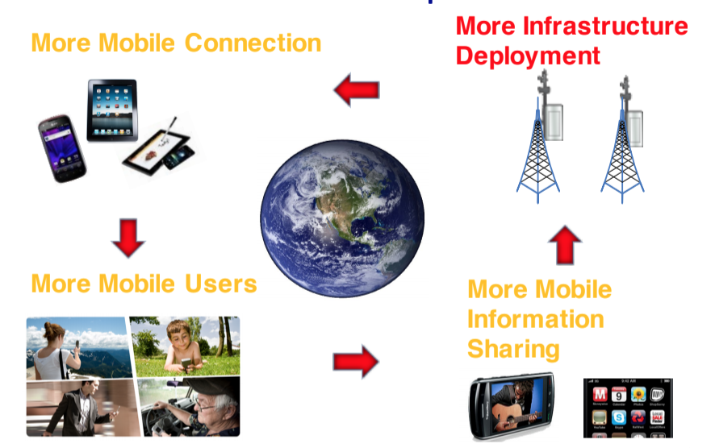
Cellular Networks - Today
Zafar Qazi's lecture

Slide 4
Why Cellular Networks - Today
Zafar Qazi's lecture

Slide 5
Brief History Cellular Networks
https://itinfozone.com/2g3g4g5g/

Slide 6
Zafar Qazi's lecture

Slide 7
Zafar Qazi's lecture

Slide 8
Zafar Qazi's lecture

Slide 9
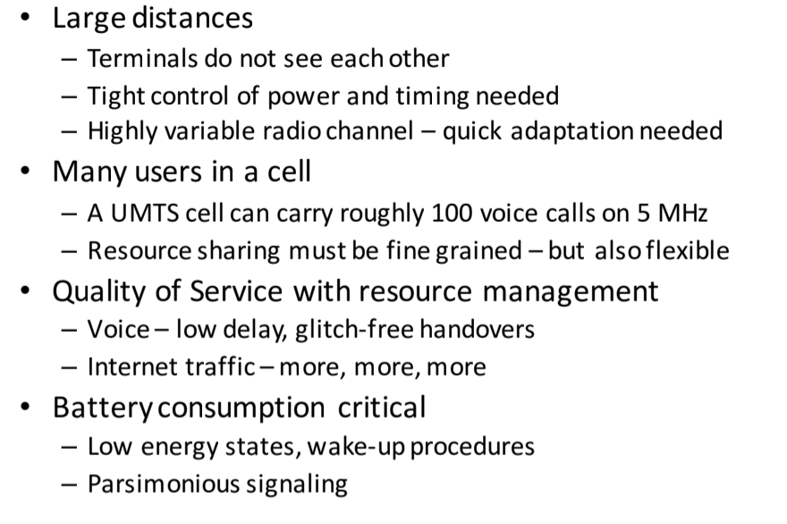
Key Challenges
Zafar Qazi's lecture

Slide 10
Cellular Network Architecture (LTE)
Datacenter
EPC
(Evolved Packet Core)
Phone
(User Equipment)
Base Station
(eNodeB)

Slide 11
Access Procedure
Zafar Qazi's lecture

Slide 12
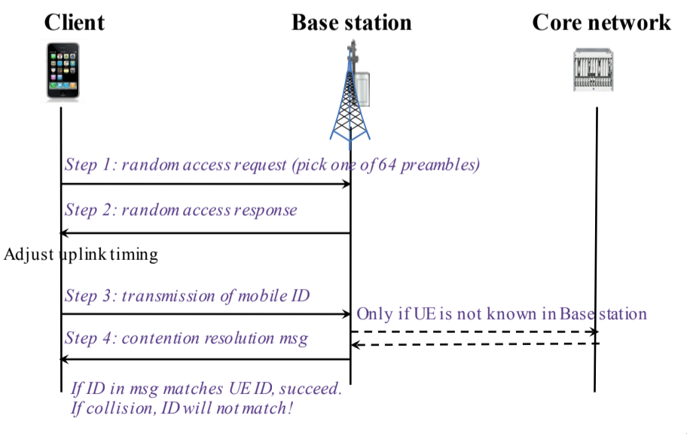
Access Procedure
Zafar Qazi's lecture

Slide 13
Access Procedure

Slide 14
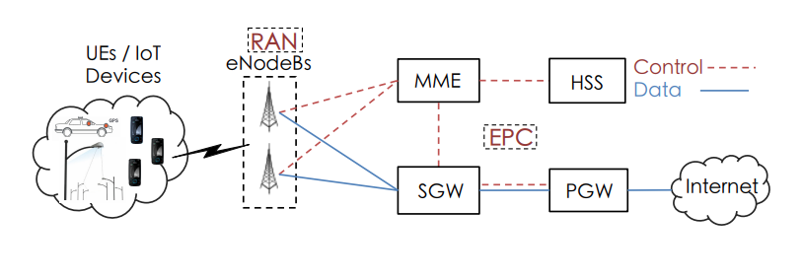
Architecture (LTE)

Slide 15
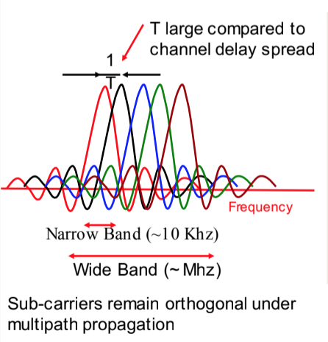
Radio Access Network
Access and coordinate the Radio resources
RAN Controller
Radio resource management
Coordinate with EPC for mobility, handover
Data encryption
Physical Layer
TDD, FDD
OFDM
MIMO

Slide 16
Evolved Packet Core (EPC)
Mobility Management Entity (MME)
Control plane
Signaling related to mobility
Serving and PDN Gateways ( S-P/GW)
Data plane
Transport users’ data to and from external networks
SGW routes the incoming and outgoing IP packets
PGW: IP allocation, policy control, charging etc.
Home Subscriber Server (HSS)
A database that contains user-related and subscriber-related information
Supports mobility management, call and session setup, user authentication and access authorization

Slide 17
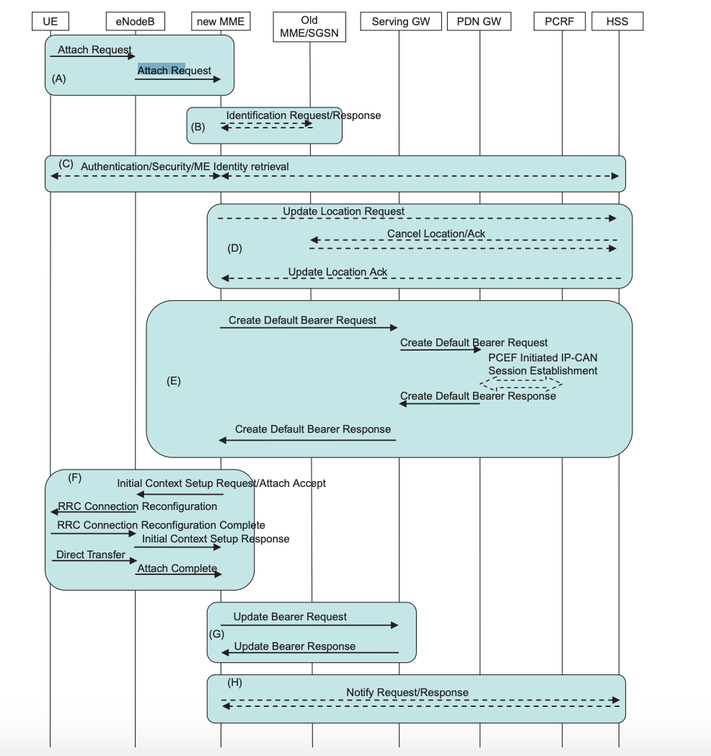
UE Attach

Slide 18
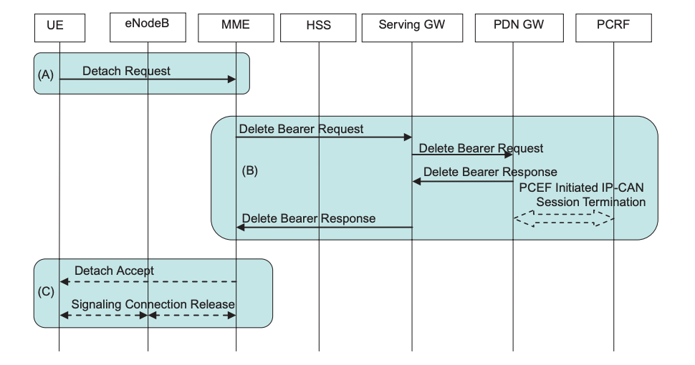
UE Detach

Slide 19
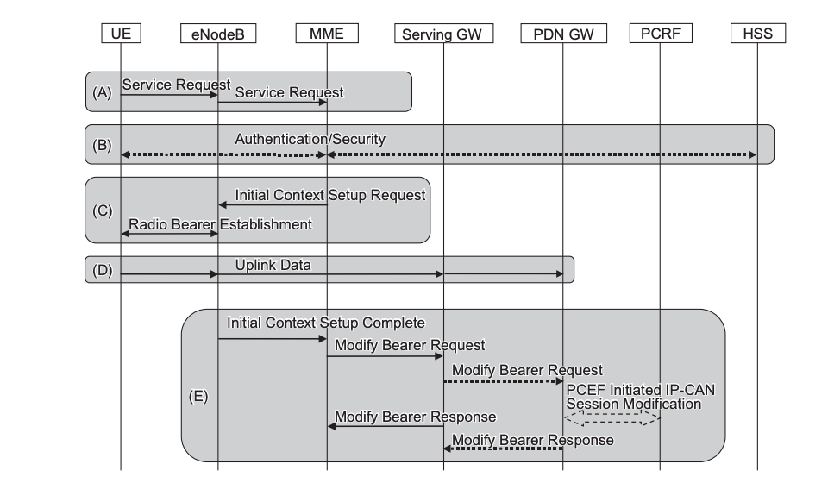
Service Request

Slide 20
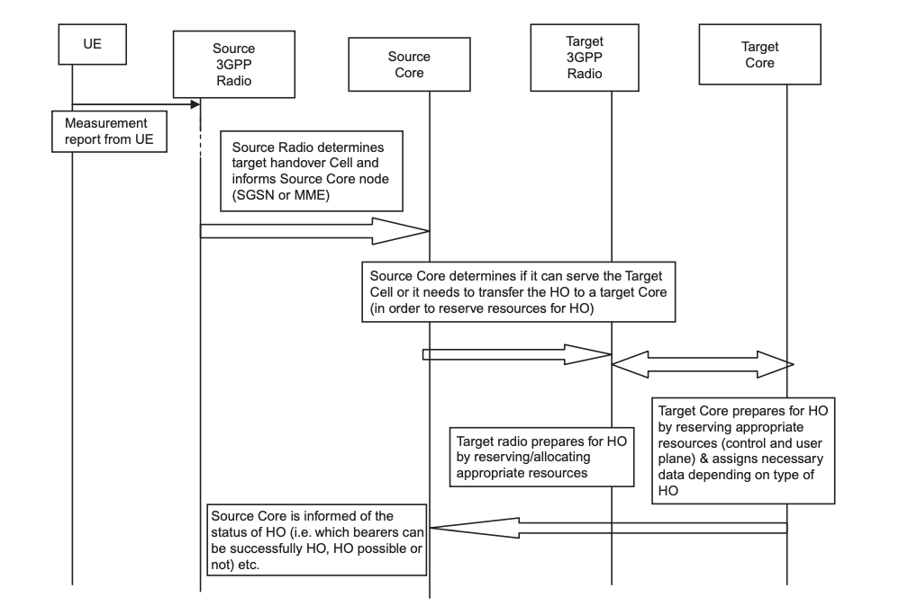
Handover

Slide 21
Summary
Evolution of Cellular Networks
LTE architecture
UE, RAN, Core
Procedures

