Slide 1
CSE570 Spring 2020 Wireless and Mobile Networks Cellular Networks - II
Mallesham Dasari

Slide 2
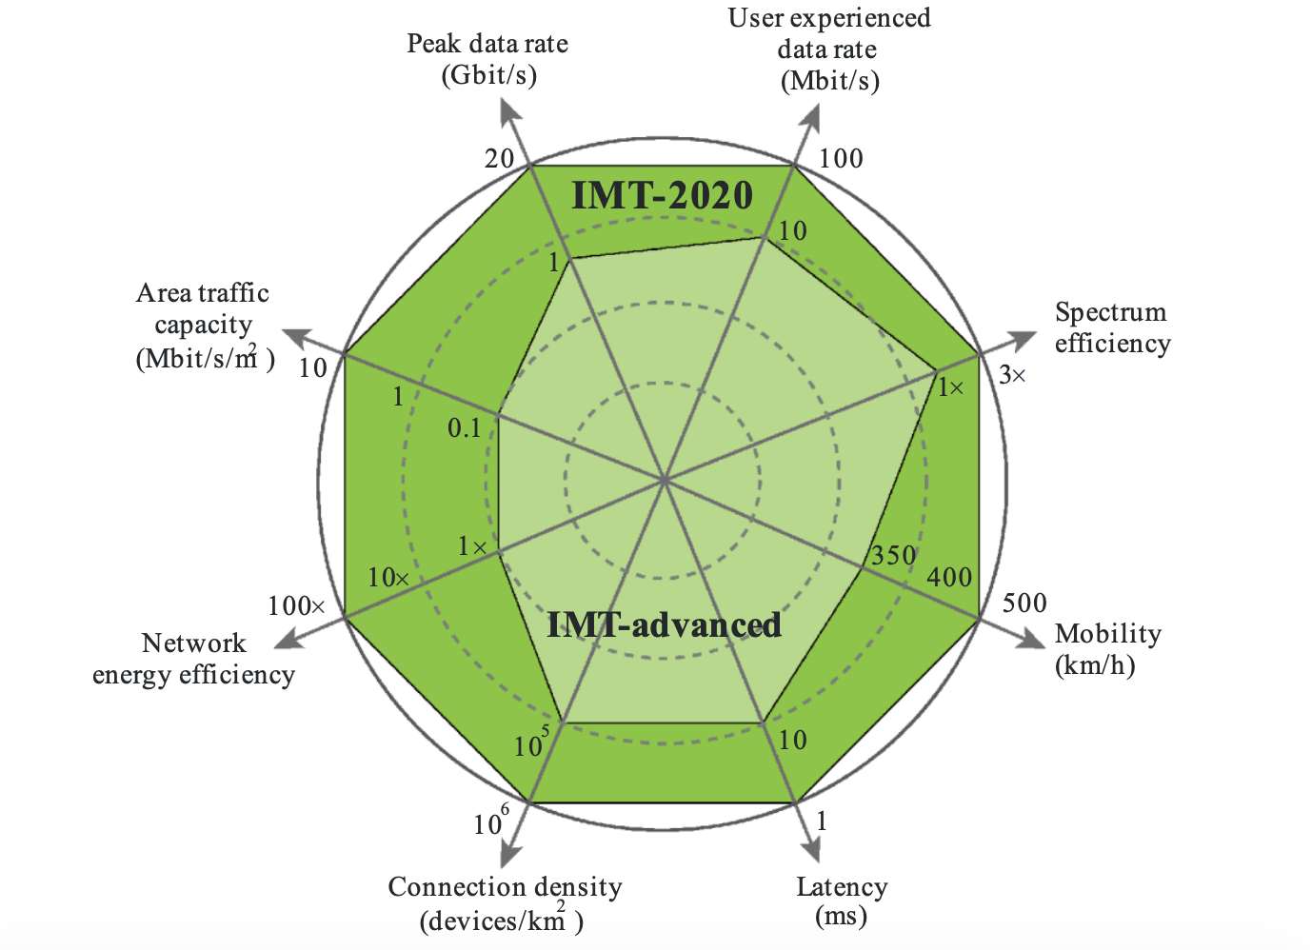
5G Vision

Slide 3
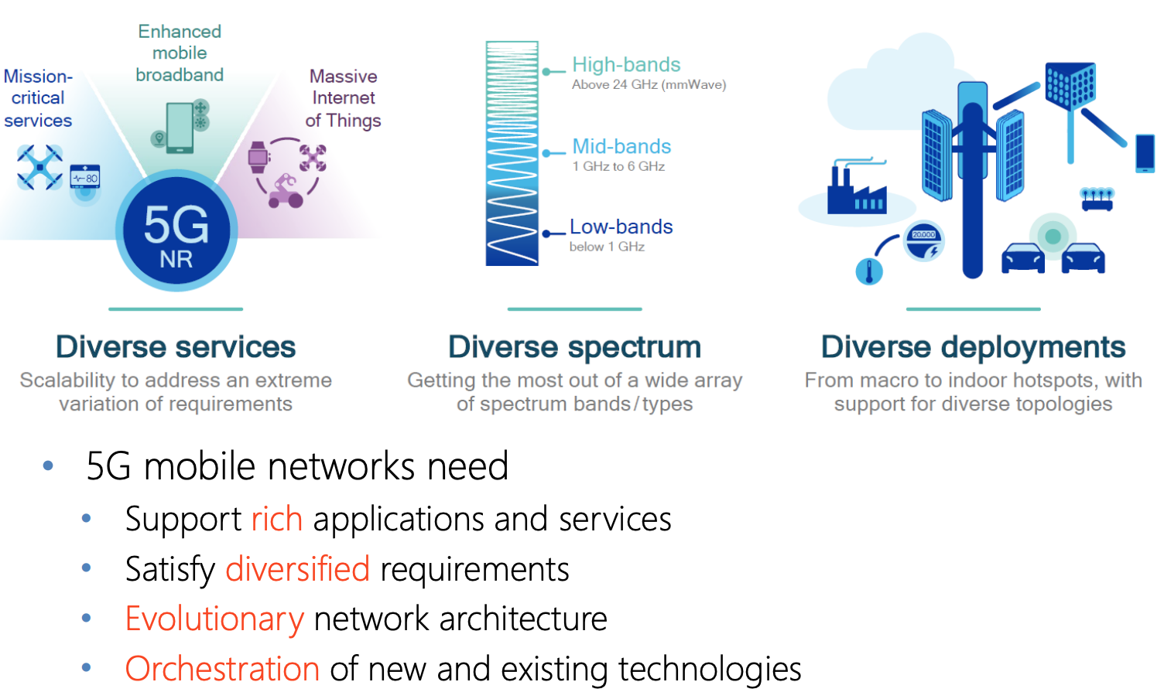
5G in a nutshell
https://ece.uwaterloo.ca/~j25ni/ECE710/5G_Update.pdf

Slide 4
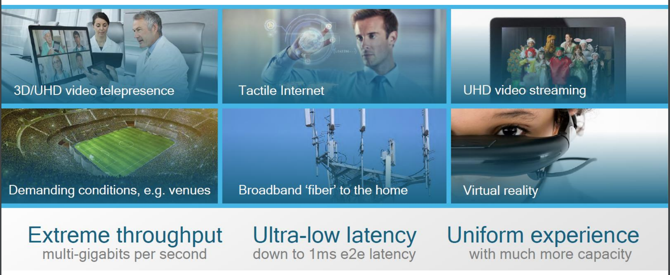
Some use cases
https://ece.uwaterloo.ca/~j25ni/ECE710/5G_Update.pdf

Slide 5
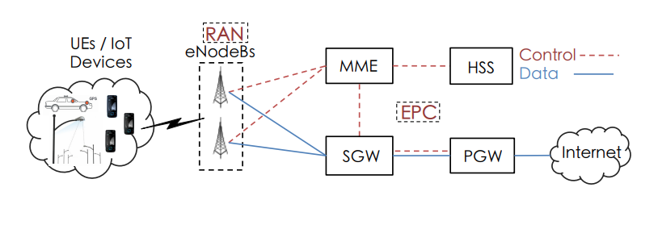
Cellular Architecture - Recap

Slide 6
What is new in 5G?
Radio Access Technologies (e.g., Massive MIMO)
New Spectrum (e.g., mmWaves)
Spectrum Co-Existence (e.g., Cellular + WiFi)
CapEx/OpEx Reduction Techniques (e.g., SDN, NFV)
New Energy Saving Mechanisms (e.g., Antenna muting)
Application Specific Improvements (e.g., AR/VR)
https://www.cse.wustl.edu/~jain/cse574-16/j_195g.htm

Slide 7
Radio Access Technologies
Radio multiplexing
Polar codes
Massive MIMO
Beamforming
Full Duplex

Slide 8
Radio Access Technologies
Radio multiplexing
Spectrum Filtered OFDM (f-OFDM)
Non-Orthogonal Multiple Access (NOMA)
Pattern Division Multiple Access (PDMA)
Sparse Code Multiple Access (SCMA)
Interleave-Division Multiple Access (IDMA)
Polar codes
New error correction coding mechanism
First coding scheme proved to achieve Shannon capacity
https://www.cse.wustl.edu/~jain/cse574-16/j_195g.htm
https://ece.uwaterloo.ca/~j25ni/ECE710/5G_Update.pdf

Slide 9
Radio Access Technologies
Massive MIMO + Beamforming
https://www.youtube.com/watch?v=pE_FsnHtTxc

Slide 10
Radio Access Technologies
Massive MIMO + Beamforming
https://www.youtube.com/watch?v=pE_FsnHtTxc

Slide 11
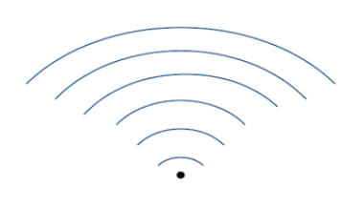
Radio Access Technologies
Massive MIMO + Beamforming
https://www.youtube.com/watch?v=pE_FsnHtTxc

Slide 12
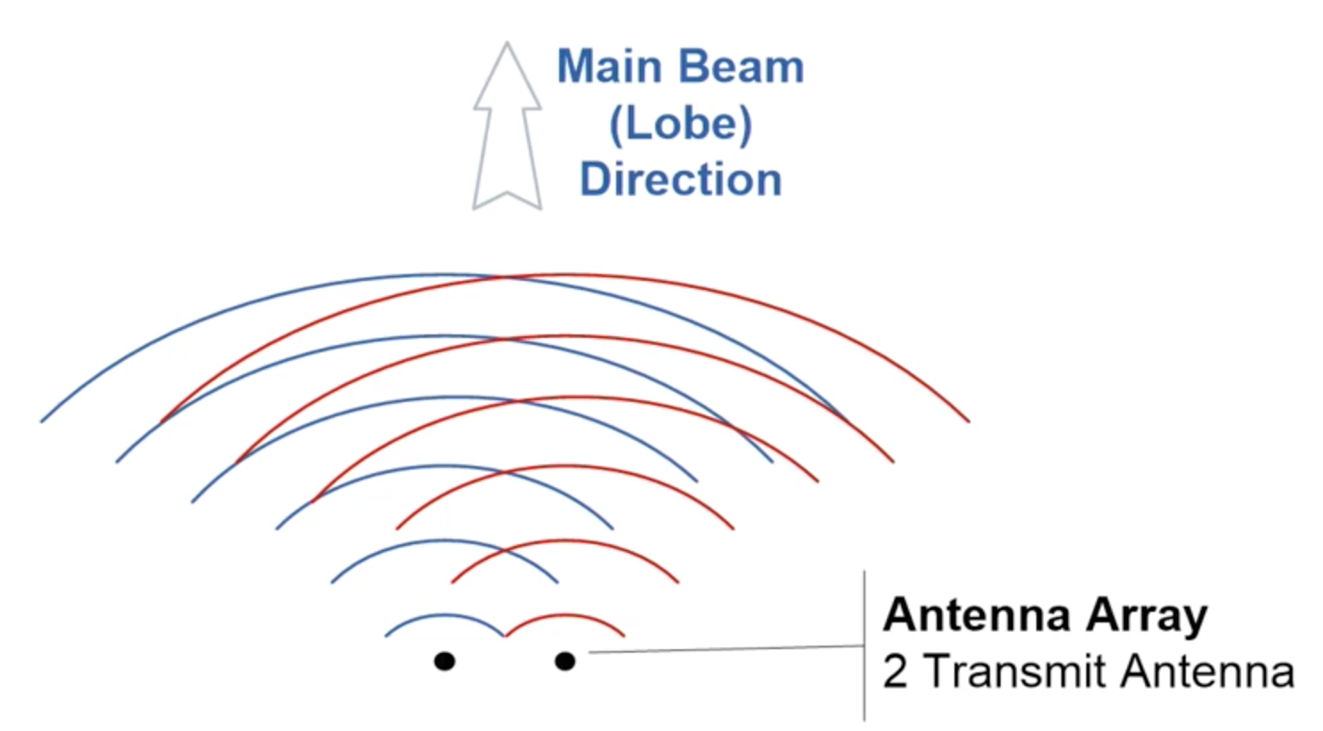
Radio Access Technologies
Massive MIMO + Beamforming
https://www.youtube.com/watch?v=pE_FsnHtTxc

Slide 13
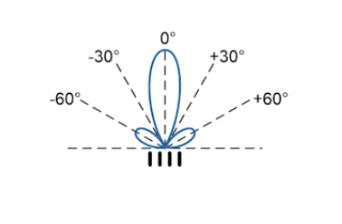
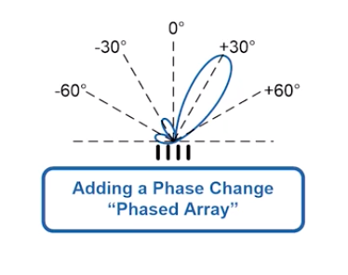
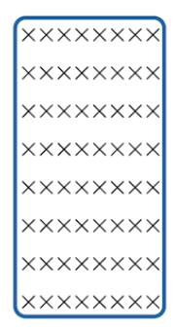
Radio Access Technologies
Massive MIMO + Beamforming
https://www.youtube.com/watch?v=pE_FsnHtTxc

Slide 14
Radio Access Technologies
Full Duplex Radios
Simultaneous Transmission and Reception Simultaneous Transmission and Reception
Doubles the throughput, reduces end-to-end latency, allows transmitters to monitor the channel
Difficult because transmitted signal too strong and interferes with reception
Solution: Self-Interference cancellation
https://www.cse.wustl.edu/~jain/cse574-16/ftp/j_195g.pdf

Slide 15
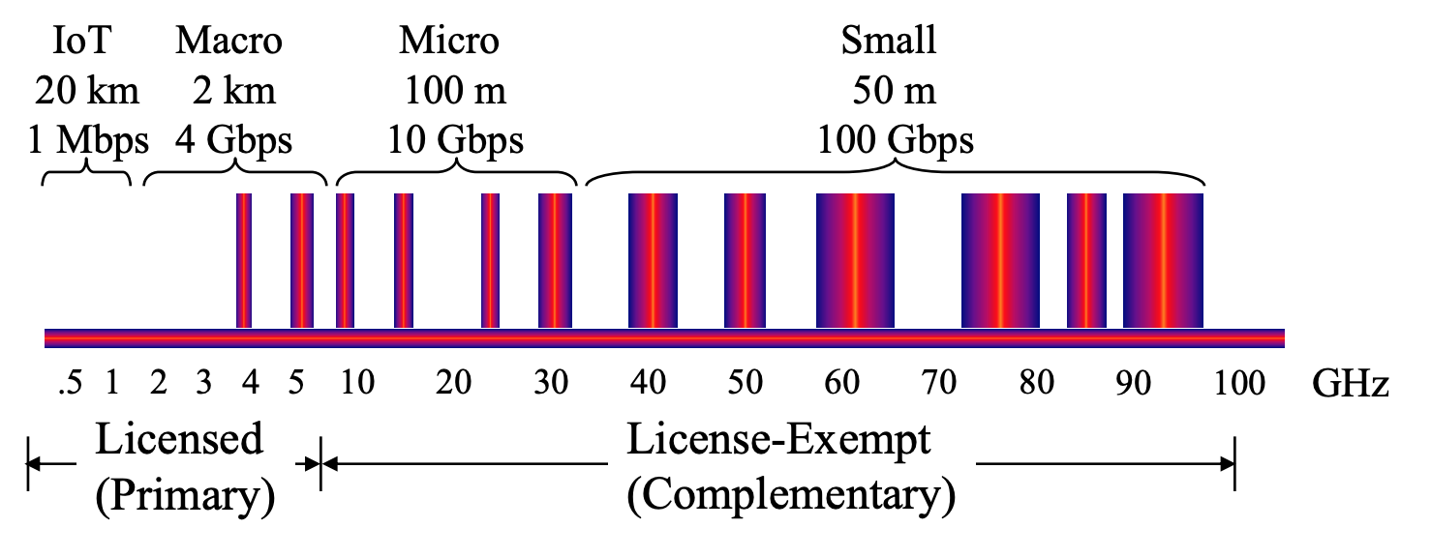
New Spectrum (mmWaves)
Extremely high frequencies (30GHz – 300 GHz)
Wavelength is in the order of millimeters
A significant bandwidth availability
Huge propagation loss
Weak diffraction – inference problem (obstacles like buildings, human body and hands etc)
https://www.cse.wustl.edu/~jain/cse574-16/j_195g.htm

Slide 16
Spectrum Co-Existence
License assisted access
E.g. WiFi + Cellular
Primary and secondaries – need to respect each other
Transmit only if free
Recheck after maximum occupancy time -> Can not transmit continuously as in standard LTE

Slide 17
CapEx/OpEx Reduction Techniques
Software Defined Networking (SDN)
Network Function Virtualization (NFV)
Mobile Edge Computing (MEC)
Cloud Radio Access Network (C-RAN)
https://www.cse.wustl.edu/~jain/cse574-16/j_195g.htm

Slide 18
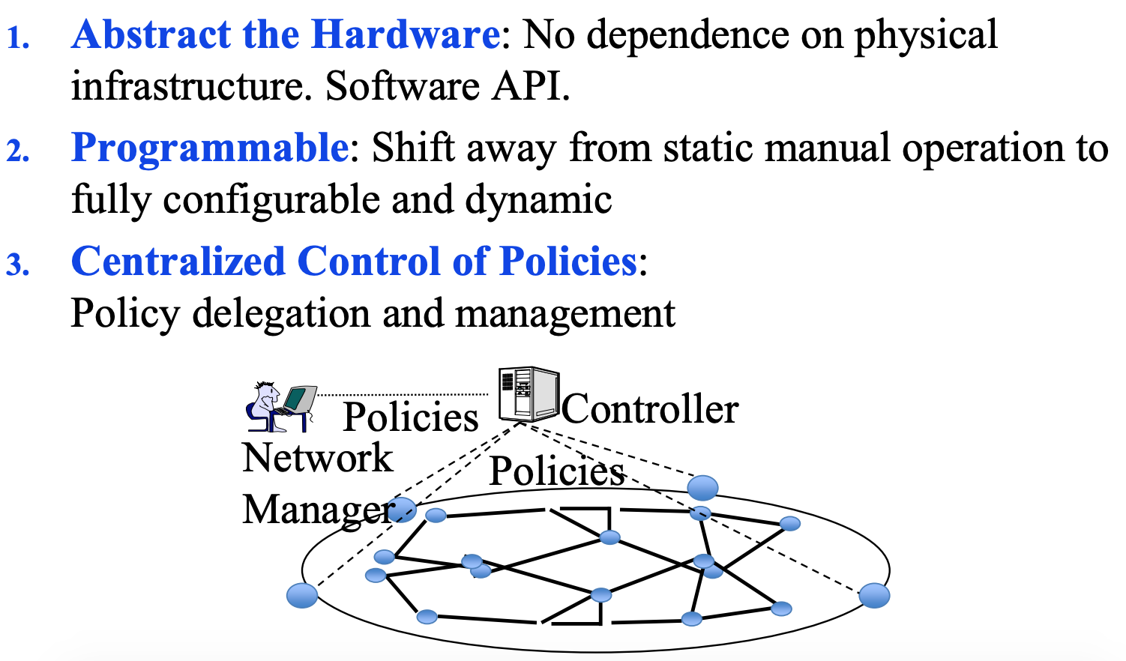
CapEx/OpEx Reduction Techniques
Software Defined Networking (SDN)
https://www.cse.wustl.edu/~jain/cse574-16/j_195g.htm

Slide 19
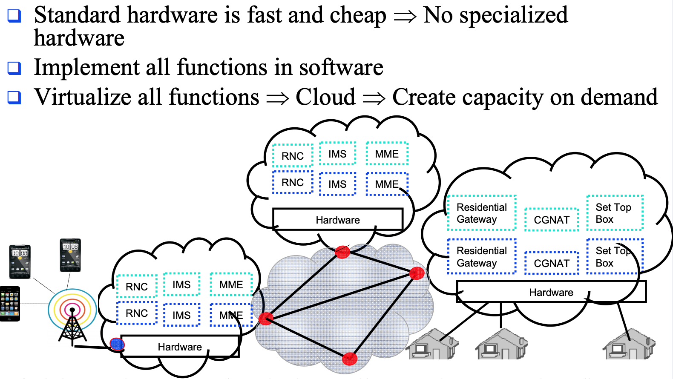
CapEx/OpEx Reduction Techniques
Network Function Virtualization (NFV)
https://www.cse.wustl.edu/~jain/cse574-16/j_195g.htm

Slide 20
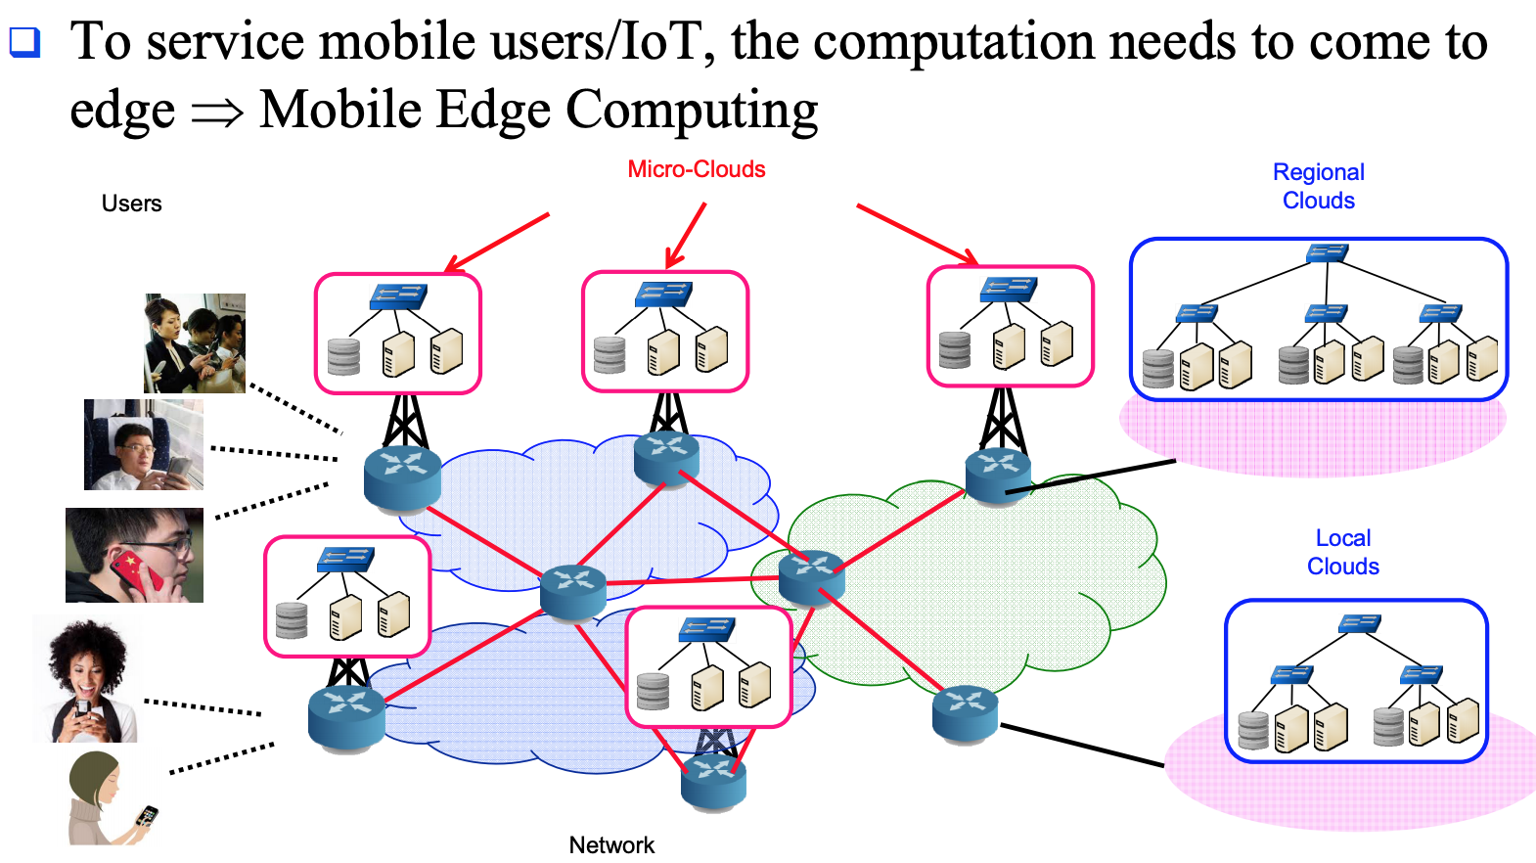
CapEx/OpEx Reduction Techniques
Mobile Edge Computing (MEC)
https://www.cse.wustl.edu/~jain/cse574-16/j_195g.htm

Slide 21
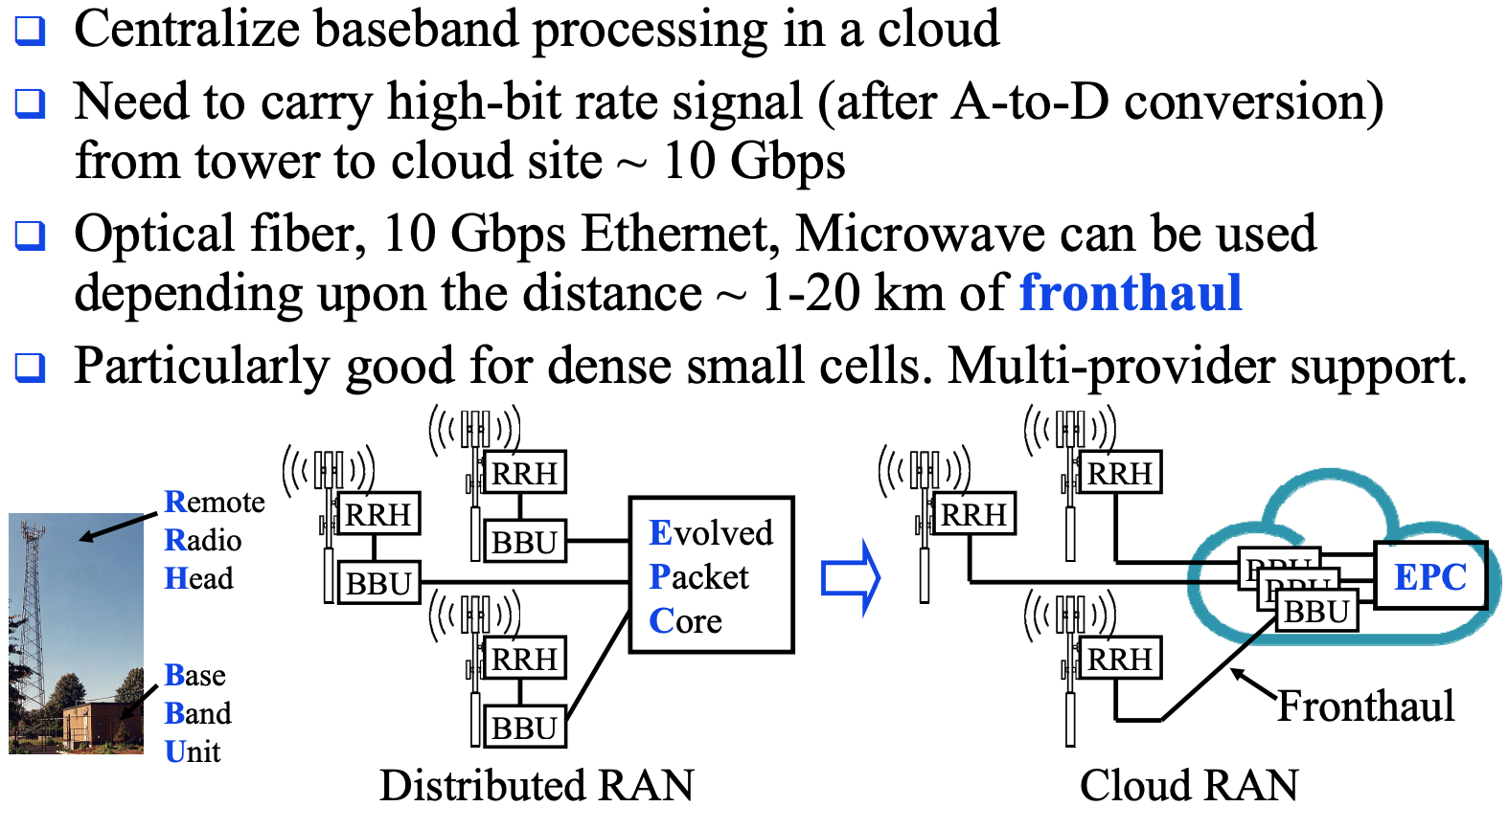
CapEx/OpEx Reduction Techniques
Cloud Radio Access Network (C-RAN)
https://www.cse.wustl.edu/~jain/cse574-16/j_195g.htm

Slide 22
Summary
Radio Access Technologies
New Spectrum
Spectrum Co-Existence
CapEx/OpEx Reduction Techniques
New Energy Saving Mechanisms
Application Specific Improvements

Slide 23
References
https://en.wikipedia.org/wiki/5G
https://en.wikipedia.org/wiki/Machine_to_machine
https://en.wikipedia.org/wiki/LTE_in_unlicensed_spectrum
https://en.wikipedia.org/wiki/LTE_in_unlicensed_spectru
https://en.wikipedia.org/wiki/Discontinuous_transmission
https://en.wikipedia.org/wiki/Software-defined_networking
https://en.wikipedia.org/wiki/Network_function_virtualization
https://en.wikipedia.org/wiki/Mobile_edge_computing
https://en.wikipedia.org/wiki/C-RAN
https://en.wikipedia.org/wiki/Small_cel
https://en.wikipedia.org/wiki/Distributed_antenna_system
https://en.wikipedia.org/wiki/3GPP
https://en.wikipedia.org/wiki/Beamforming
https://en.wikipedia.org/wiki/Discontinuous_reception
https://www.cse.wustl.edu/~jain/cse574-16/j_195g.htm

