Slide 1
CSE570 Spring 2020 Wireless and Mobile Networks
Mobile Web

Slide 2
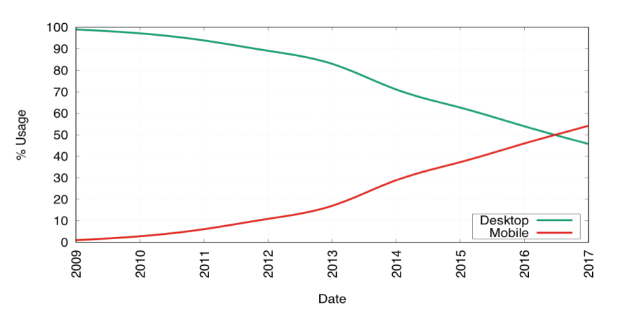
Mobile Web Usage
More than 60% of the Web traffic is Mobile
http://web.cs.ucla.edu/~ravi/CS219_F19/slides/CS219_lec1_slides.pdf

Slide 3
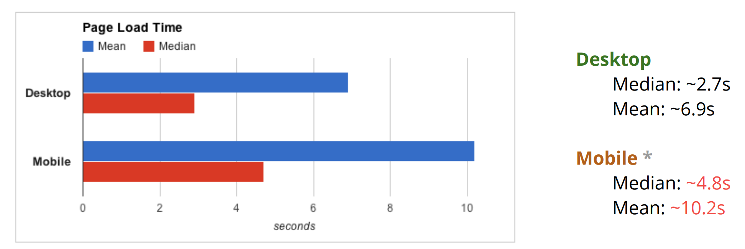
Web Page Loads
https://www.igvita.com/slides/2012/webperf-crash-course.pdf

Slide 4
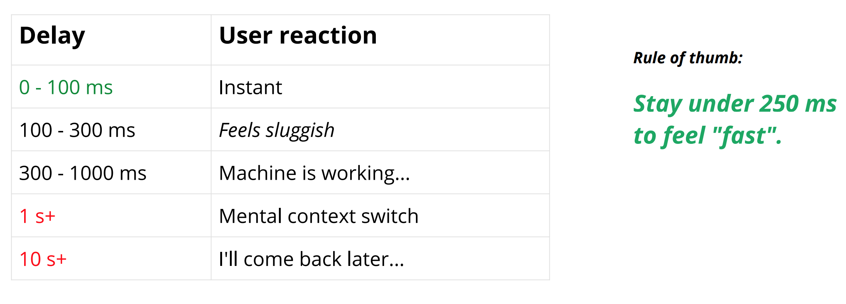
User Engagement
https://www.igvita.com/slides/2012/webperf-crash-course.pdf

Slide 5
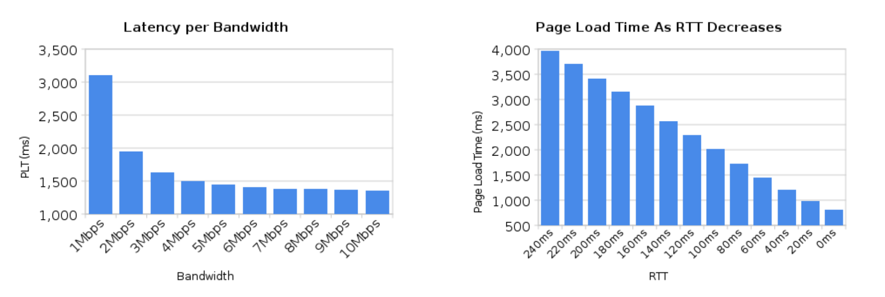
Bandwidth vs. Latency
Average household in is running on a 5 mbps+ connection. Ergo, average consumer would not see an improvement in page loading time by upgrading their connection.
https://www.igvita.com/slides/2012/webperf-crash-course.pdf

Slide 6
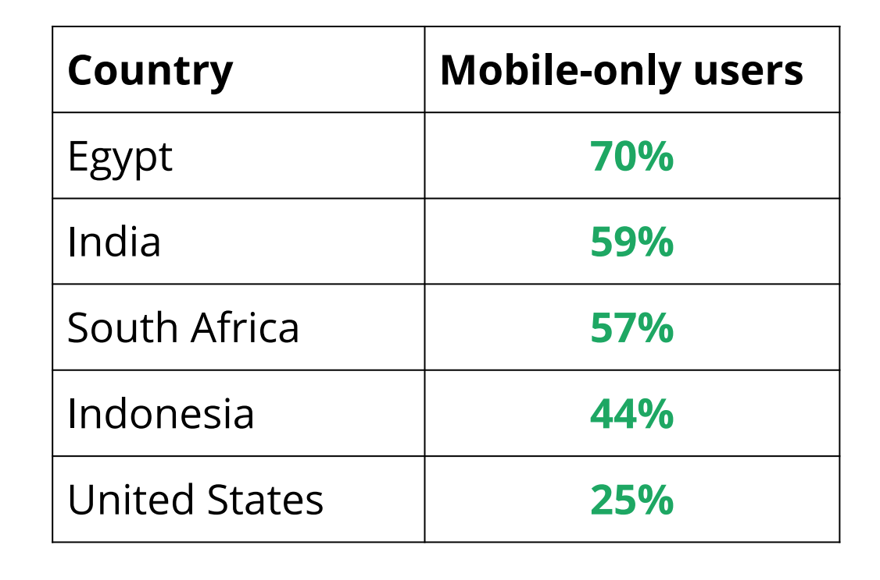
For many, mobile is the one and only internet device
https://www.igvita.com/slides/2012/webperf-crash-course.pdf

Slide 7
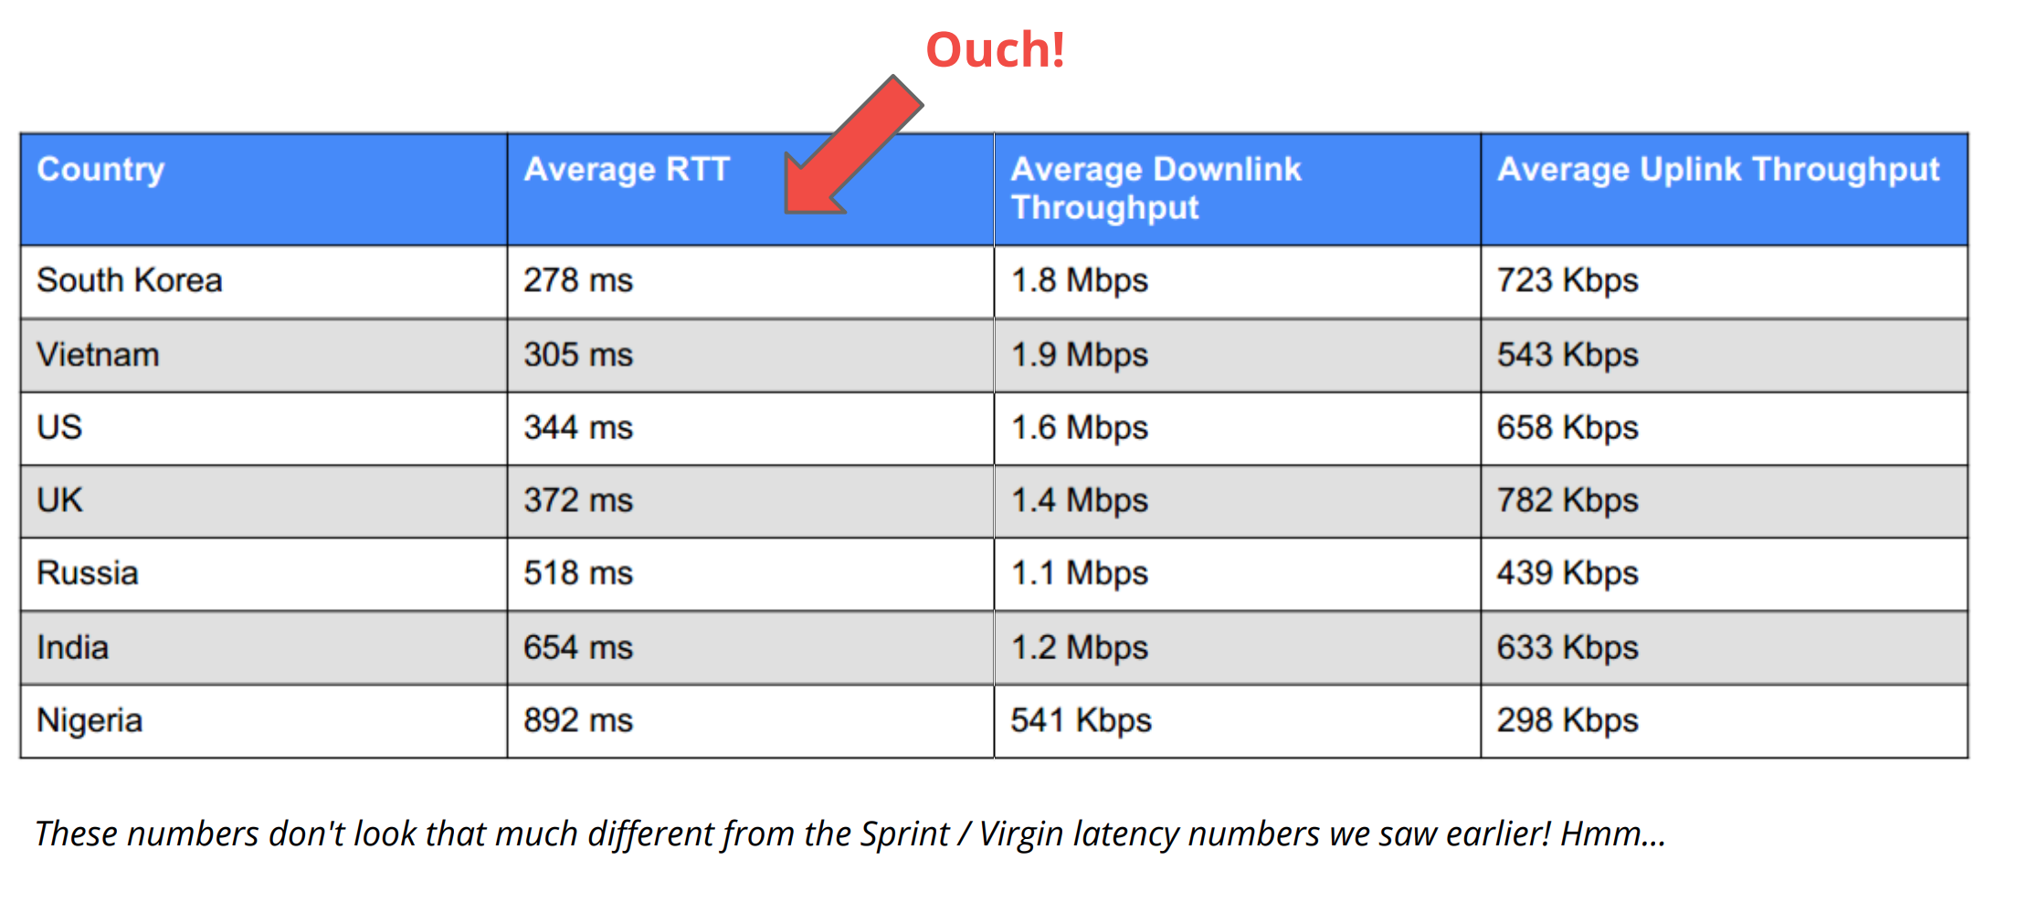
Average RTT & downlink / uplink speeds
https://www.igvita.com/slides/2012/webperf-crash-course.pdf

Slide 8
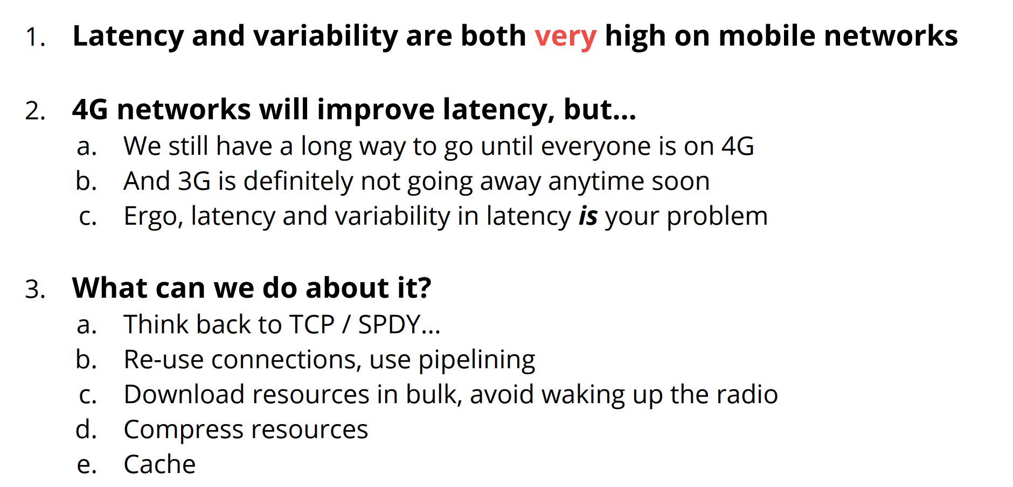
Motivation for Web Research

Slide 9
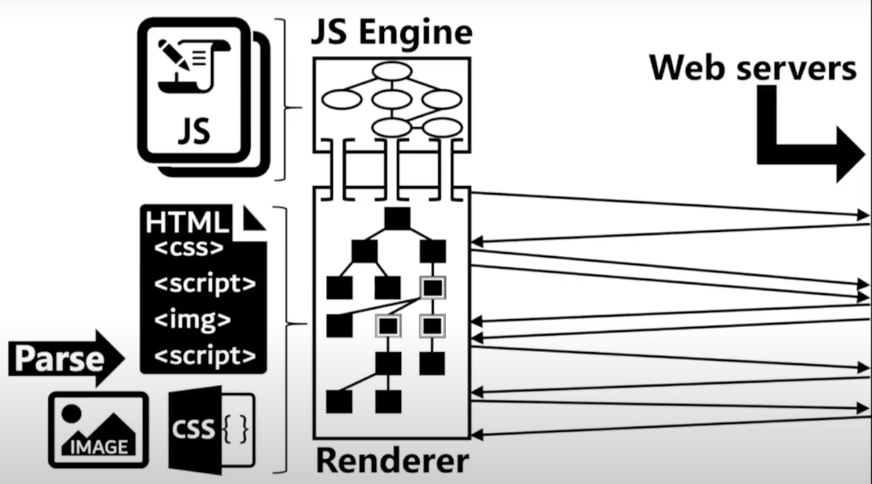
Page Load Process
https://www.usenix.org/system/files/conference/nsdi18/nsdi18-netravali-prophecy.pdf

Slide 10
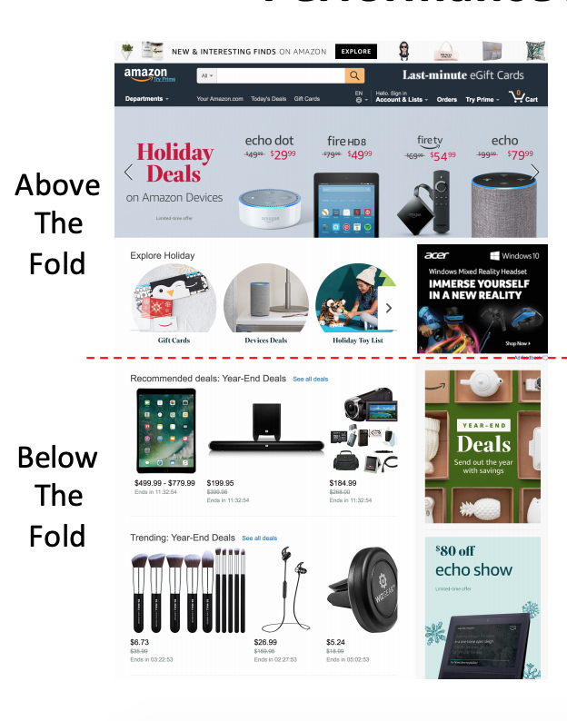
Page Load Metrics Quality of Experience (QoE)
onLoad
All the content is loaded
Speed Index
Above the fold content is loaded (ATF)
User perceived PLT
Relative importance on the ATF content
Ready Index
Speed Index + Interactive

Slide 11
Page Load Optimizations
Client-side solutions
Accelerating the computation
Proxy solutions
Prefetching resources
Offloading the computation
Server-side solutions
Offloading the computation
Minimizing bandwidth consumption

Slide 12
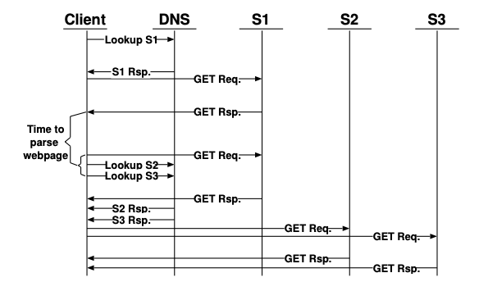
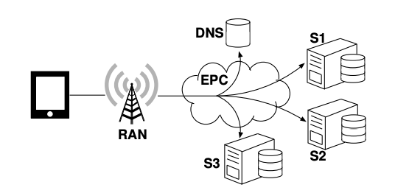
PARCEL (CoNEXT’14): Proxy Solution
Page Load Process in LTE
https://engineering.purdue.edu/~isl/papers/paper169_final_CoNEXT14.pdf

Slide 13
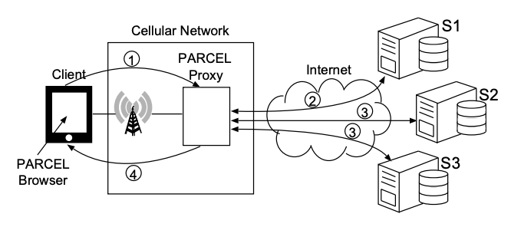
PARCEL (CoNEXT’14): Proxy Solution
https://engineering.purdue.edu/~isl/papers/paper169_final_CoNEXT14.pdf

Slide 14
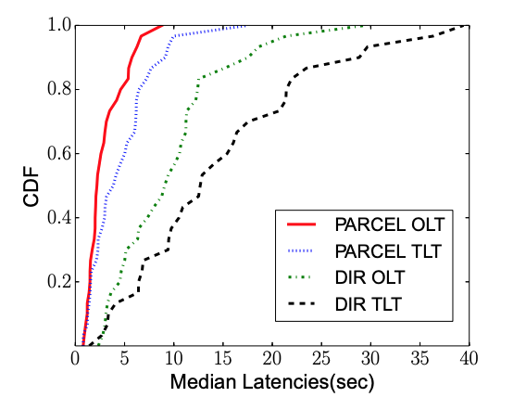
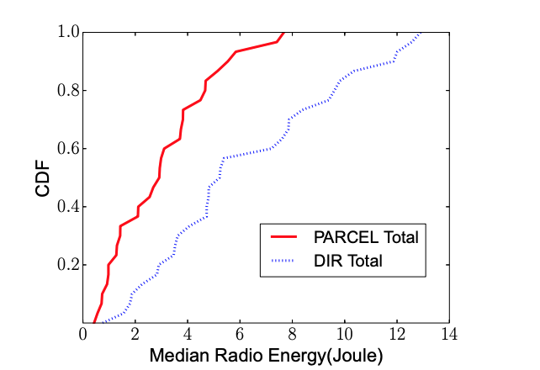
PARCEL (CoNEXT’14): Proxy Solution Benefits
https://engineering.purdue.edu/~isl/papers/paper169_final_CoNEXT14.pdf

Slide 15
Prophecy (NSDI’18): Server-side Solution
https://www.usenix.org/system/files/conference/nsdi18/nsdi18-netravali-prophecy.pdf

Slide 16
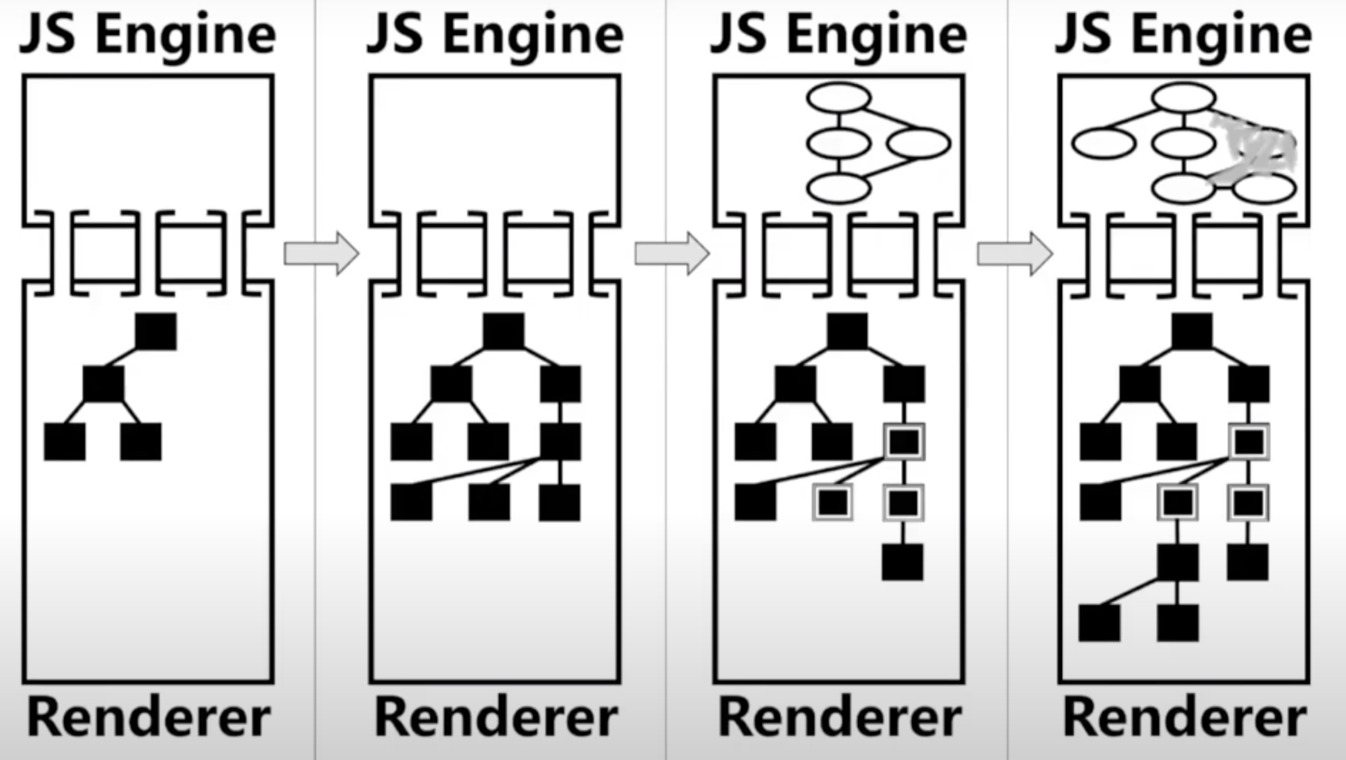
Prophecy (NSDI’18): Server-side Solution
https://www.usenix.org/system/files/conference/nsdi18/nsdi18-netravali-prophecy.pdf

Slide 17
Prophecy (NSDI’18): Server-side Solution
https://www.usenix.org/system/files/conference/nsdi18/nsdi18-netravali-prophecy.pdf

Slide 18
Prophecy (NSDI’18): Server-side Solution
https://www.usenix.org/system/files/conference/nsdi18/nsdi18-netravali-prophecy.pdf

Slide 19
Prophecy (NSDI’18): Server-side Solution
https://www.usenix.org/system/files/conference/nsdi18/nsdi18-netravali-prophecy.pdf

Slide 20
Prophecy (NSDI’18): Server-side Solution
https://www.usenix.org/system/files/conference/nsdi18/nsdi18-netravali-prophecy.pdf

Slide 21
Prophecy (NSDI’18): Server-side Solution
https://www.usenix.org/system/files/conference/nsdi18/nsdi18-netravali-prophecy.pdf

Slide 22
Prophecy (NSDI’18): Server-side Solution
https://www.usenix.org/system/files/conference/nsdi18/nsdi18-netravali-prophecy.pdf

Slide 23
Prophecy (NSDI’18): Server-side Solution
https://www.usenix.org/system/files/conference/nsdi18/nsdi18-netravali-prophecy.pdf

Slide 24
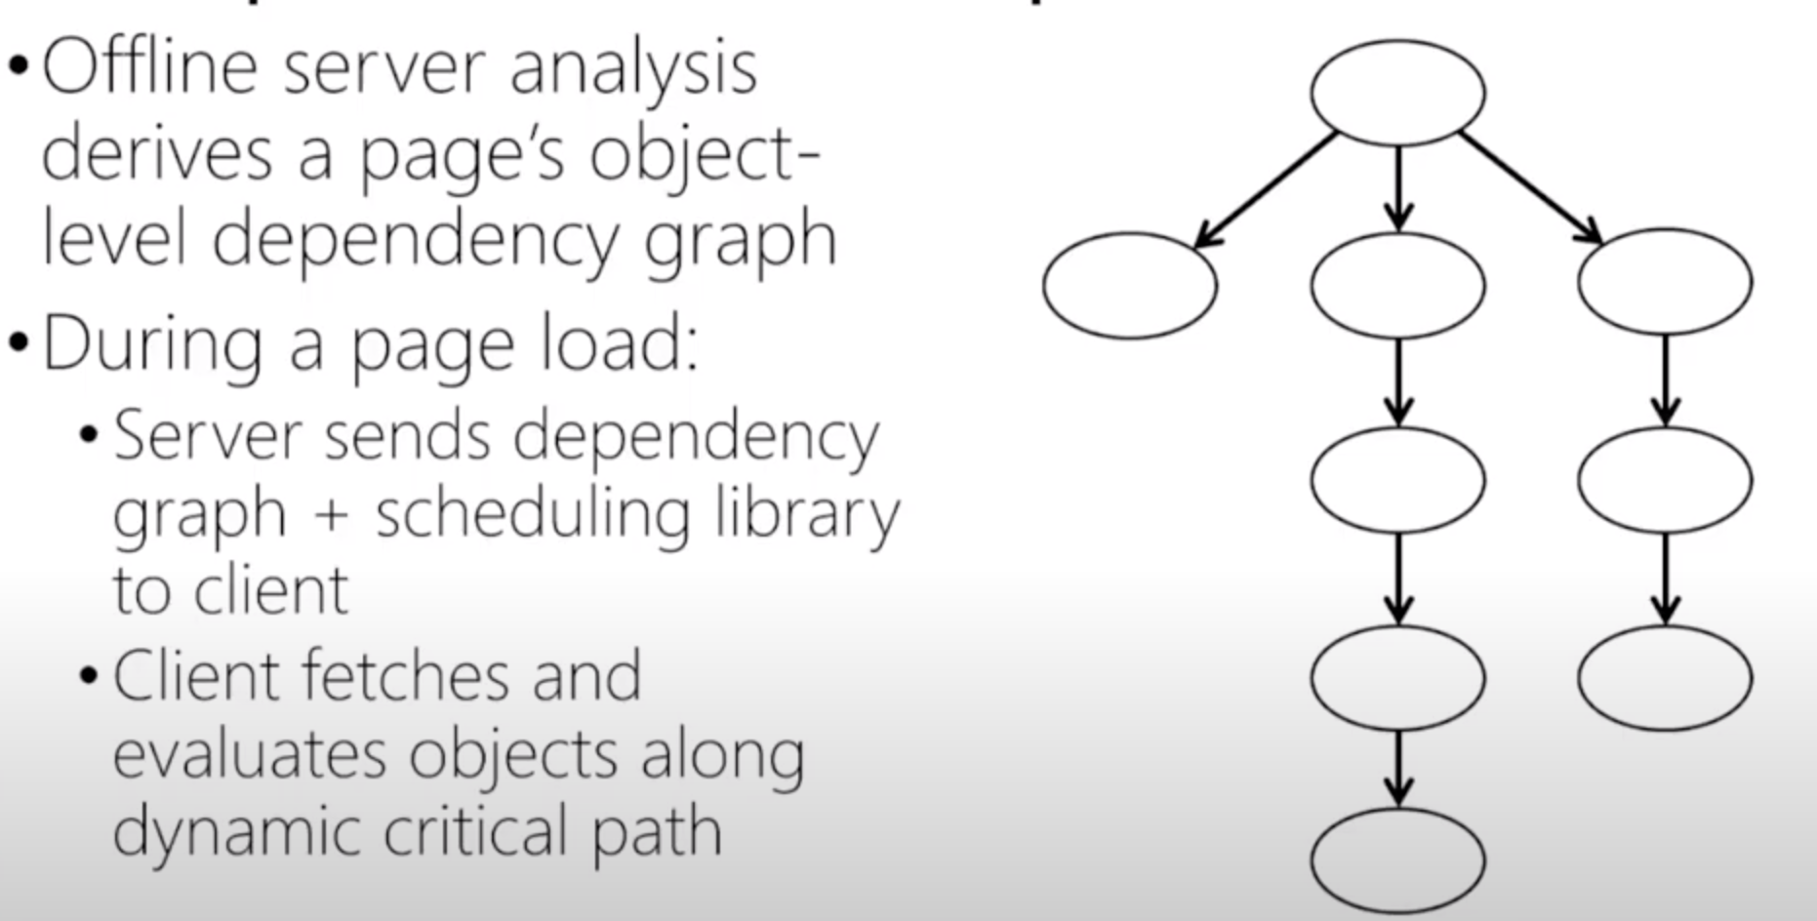
Polaris (NSDI’16): Server-side Solution
https://www.usenix.org/system/files/conference/nsdi18/nsdi18-netravali-prophecy.pdf

Slide 25
Summary
Mobile Web page loads are much slower compared to Desktops
Cellular networks have delay problem
Page load metrics
Page load optimizations
Proxy solutions are great – but not practical

